Slide 1
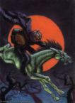

“The Legend of sleepy hollow”
By Washington Irving

Slide 2
Setting
Where? Sleepy Hollow, New York
When? Post Revolutionary America

Slide 3
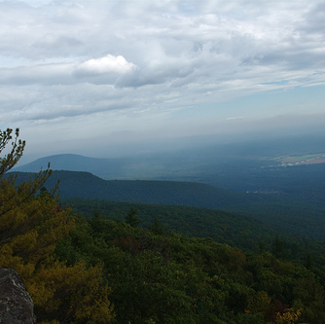
Sleepy hollow
Real Place
New York
Hudson Valley

Slide 4
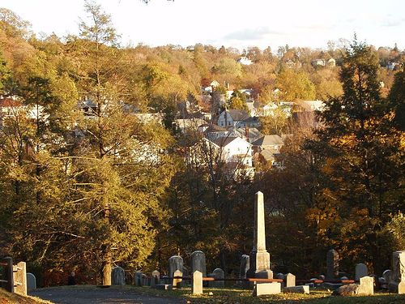
Sleepy hollow

Slide 5
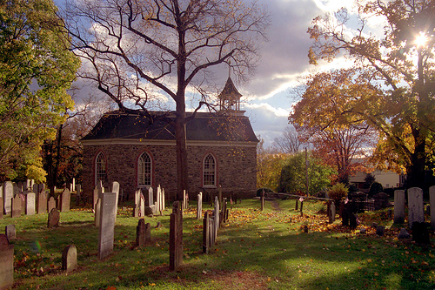
Old Dutch church

Slide 6
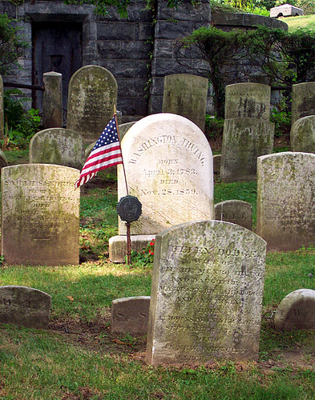
Washington irving’s grave

Slide 7

The legend

Slide 8
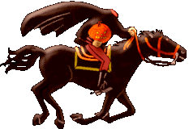
The headless horseman
Legend
Hessian Trooper
Revolutionary War
Beheaded by Cannonball
Buried in Churchyard
Rides Through Sleepy Hollow in Search of His Head
Hurries to Return to Cemetery Before Daybreak

Slide 9
Main Characters

Slide 10
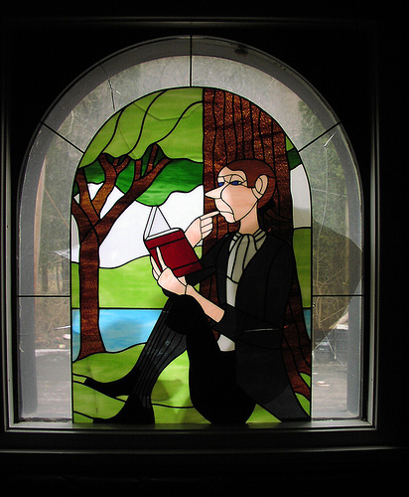
Ichabod Crane
School Teacher
See Description on p. 19
Single

Slide 11

Katrina van Tassel
Object of Ichabod’s Attraction
Lovely Young Woman

Slide 12

Brom Van Brunt
Also Known as Brom Bones
Also Loves Katrina
“Hero of the Country Round”

Slide 13
Conflict
2 Men Love 1 Woman
Both Try to Impress Her

Slide 14
Point of View
Third Person Omniscient Narrator
Geoffrey Crayon, Gent
Pseudonym of Washington Irving
The Sketch-Book

Slide 15
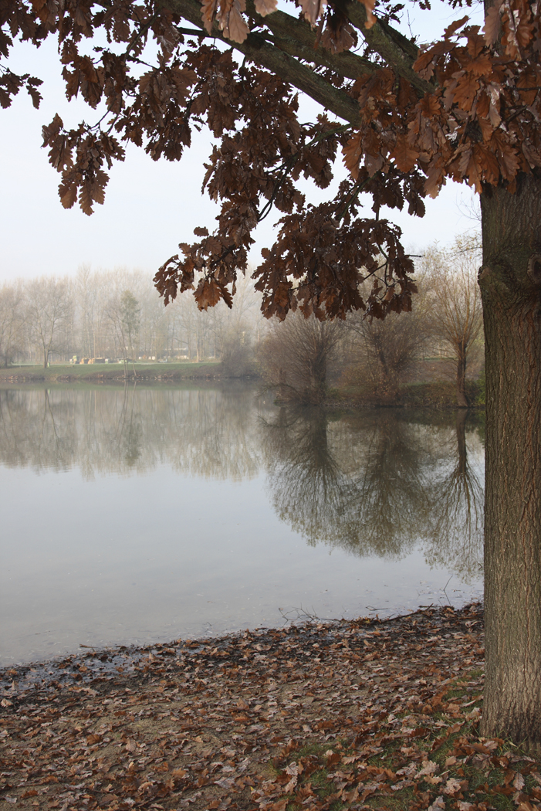
Imagery
Sleepy Hollow – Still Water
Relaxed Attitude
Never Progress

Slide 16
Imagery
Food
Symbol for Appetite
Appetite for Food and Superstition
Women are known for their ghost tales almost as much as for their baked goods.

Slide 17

imagery
Food
Katerina – Peach or “So Tempting a Morsel”
Symbol of Ichabod’s Desire

Slide 18
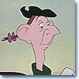

Symbolism in Names
Ichabod Crane’s appearance is like a crane.

Slide 19
Katrina Van Tassel
Katrina – Trinket
Tassel - Decoration

Slide 20
Sleepy Hollow
Sleepy
Relaxed People
Lack of Innovation
Hollow
Hollow or Valley
Emptiness of Beliefs

Slide 21
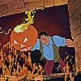

Alliteration
repetition of a consonant sound
Brom Bones
Headless Horseman
Coincidence or Not?

